Slide 1
Symbols
I do: my turn to talk. This is the explanation section of our lesson where you are required to listen.
We do: this is where we discuss or work on the concepts together.
You do: your turn to be involved. You may be working in a group or on an activity individually.

Slide 3
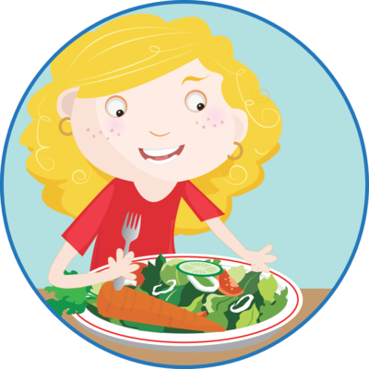
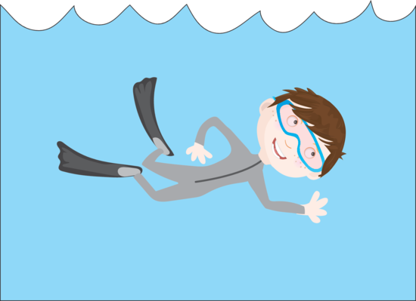
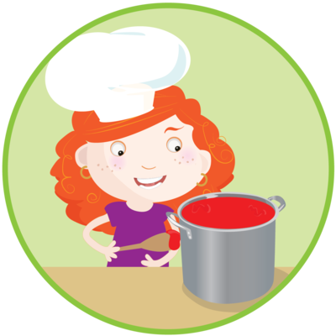
What Are Verbs?
Verbs are doing or action words.
Harriet ate lunch.
Daniel likes to swim.
Sally can sing well.
Jodie loves to cook.

Slide 4
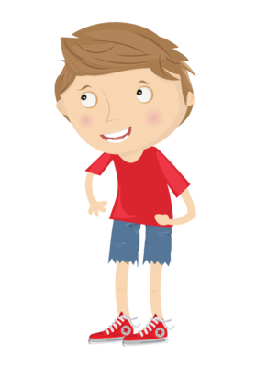
Strong Verbs
Some verbs are stronger than others. Strong verbs provide more description than weak verbs. Strong verbs:
put a detailed picture in the reader’s mind
are concise and keep the reader’s attention
convey the level of meaning to a reader
connect the subject and the action in the sentence.

Slide 5
Weak Verbs
Weak verbs are vague and don’t show strong action. They are not descriptive and often include words such as ‘is’, ‘am’, ‘are’, ‘was’, ‘were’, ‘be’, ‘being’ or ‘been’.
The girls were walking to the beach.
These words don’t show strong action.

Slide 6
Weak Verbs vs Strong Verbs
Weak: The children were playing with the dogs.
Strong: The children frolicked with the dogs.
Weak: Joanna walked to the bus in time.
Strong: Scampering, Joanna made it to the bus.
Weak: He was running quickly to the finish line.
Strong: He sprinted to the finish line.

Slide 7
Common Weak Verbs | Strong Verbs
said | muttered, recited, laughed, shrieked, grumbled, agreed, announced
walked | strolled, trekked, trudged, ambled, lead, steered, hiked
ask | demand, query, wonder, question, urge, beg
running | sprinting, racing, dashing, scuttling, scampering
did | finished, prepared, produced, performed, achieved, completed
played | frolicked, relaxed, cavorted, challenged
hold | cradle, clutch, grasp, envelope, enfold, grip, support

Slide 8
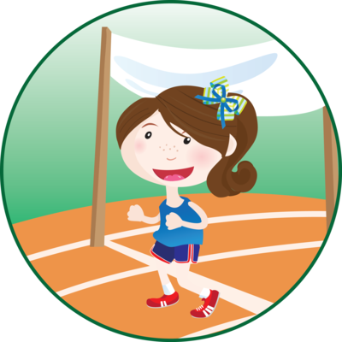
Strong Verbs
With a partner, discuss how you could strengthen the verbs in each sentence. The verbs have been highlighted for you.
Lucy walked to the shops.
Lin did his homework for the week.
Running towards the finish line, the girls were very tired.

Slide 9
Strong Verbs
Rewrite each sentence to include strong verbs.
My dad ate an orange.
We are going to Italy for a trip.
The car pulled into the carpark.
Matthew and Jake played in the mud.

